Slide 1

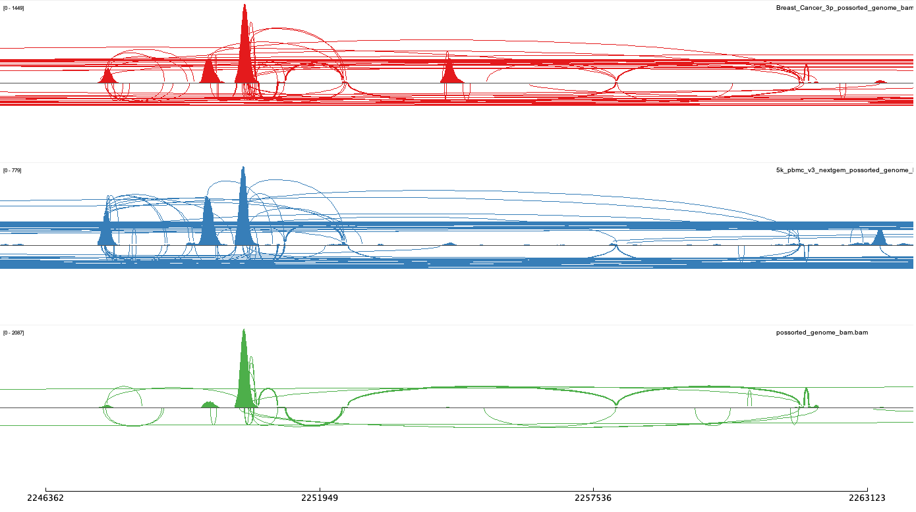
IDC breast cancer
PBMC
B cell and plasma cell

Slide 2




